Slide 1
Federation of New Brunswick Faculty Associations

Slide 2
FNBFA History
Inception
founded in 1970 by an informal group of New Brunswick faculty members
incorporated in 1981
today represents approximately 1500 regular and contract academic staff from five faculty associations and six university campuses

Slide 3
FNBFA mission statement and objectives
The FNBFA is “the voice of university faculty and academic librarians across the province. We seek to advance our members’ professional interests and to improve the quality of our education system.”
primarily a vehicle for lobbying the provincial government on matters connected with higher education

Slide 4
FNBFA Member Associations
Association des professeures et professeurs de l’Université de Moncton – Edmundston (APPUMCE)
Association des professeures et professeurs de l’Université de Moncton – Shippagan (APPUMCS)
Association of the University of New Brunswick Teachers (AUNBT)
Faculty Association of the University of St. Thomas (FAUST)
Mount Allison Faculty Association (MAFA)

Slide 5
Legal assistance fund for FNBFA member associations
Member associations may apply for and be eligible to receive financial assistance to cover legal costs pertaining to arbitration, court action, or action before the Labour and Employment Board or any other governmental agencies such as, but not exclusive to, the Human Rights Commission and to the Access to Information and Privacy Commissioner.
Legal costs pertaining to collective bargaining and other actions that are covered by the CAUT program are not eligible.
Applications for financial assistance shall be submitted to the Committee through the Executive Director of the FNBFA by October 1st of each year.

Slide 6
Prix Nicole Raymond Award
The FNBFA’s Prix Nicole Raymond Award was created in memory of the late Professor Nicole Raymond, of the Université de Moncton, and her contributions to academic life through teaching, research activities and involvement in professional associations.
The FNBFA bestows this Award to a person, group of persons or organization in recognition of a distinguished contribution to the advancement of the labor movement, or to the cause and/or public profile of post-secondary education.
Normally, only one Award shall be given in any academic year. The Award, however, shall not necessarily be given annually; and the decision whether or not to grant the Award in any academic year shall be in the sole discretion of the Board of the Federation.
When the award is given, the deadline for nominations is November 30.
The award, in the form of a unique piece of pottery or pewter made by a New Brunswick artisan, is usually presented at the Federation's Annual General Meeting.

Slide 7
The FNBFA in action
Enable dialogue between member associations
Meetings of the Board of directors (5 times a year)
Visits to member association campuses at AGMs
Maintain the dialogue with the GNB
Meetings with members of the legislative assembly(+/- annually)
Attendance at the In Camera Budget Presentation
Department of Post-Secondary Education, Training & Labour
Letters and meetings
Getting faculty voices heard in the media
Letters to the editor
Commentaries
Interviews

Slide 8
FNBFA Structure
Board of Directors
Members of the Executive Committee (5)
One representative per member association (5)
Executive Committee
President
Vice-president
Treasurer
Secretary
Past-president/Member-at-large
Executive Director

Slide 9
FNBFA Structure (cont’d)
FNBFA committees
Nominations Committee (permanent)
Legal Assistance Fund Committee
Selection Committee for the Prix Nicole Raymond Award
Human Resources Committee (permanent)
FNBFA’s ad hoc committees
Ces comités sont constitués par le conseil pour une tâche ponctuelle.

Slide 10
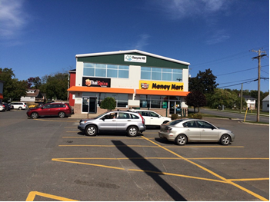
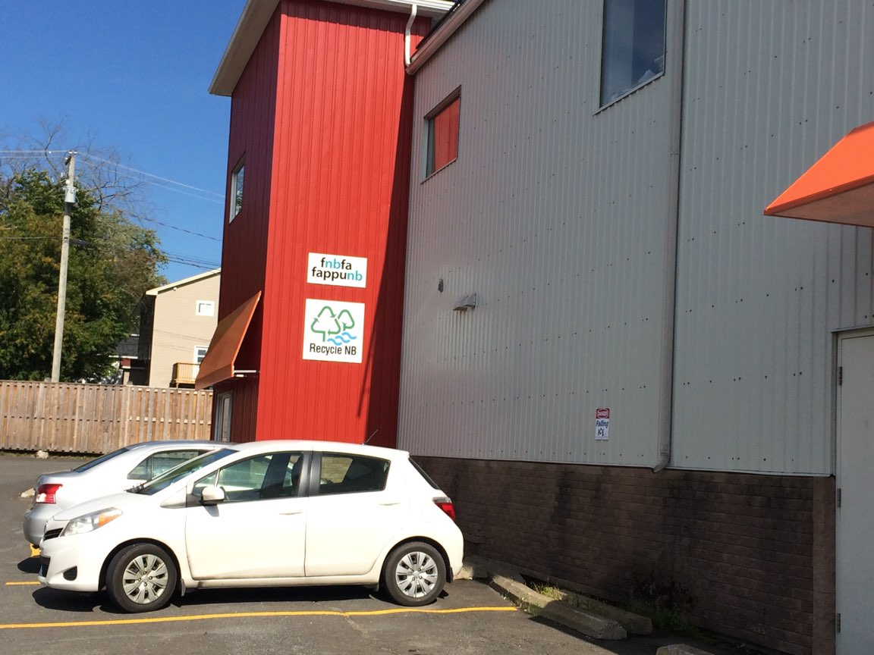
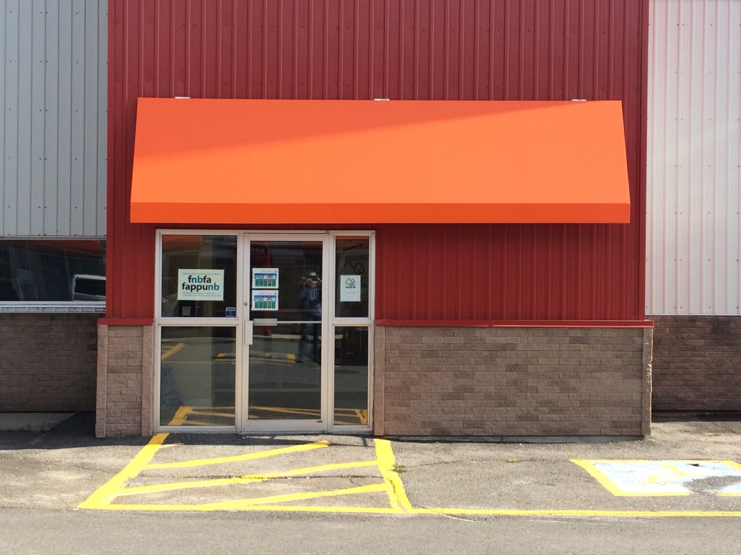
FNBFA Office Location 277 Main Street, Suite 202, Fredericton (North Side)

Slide 11
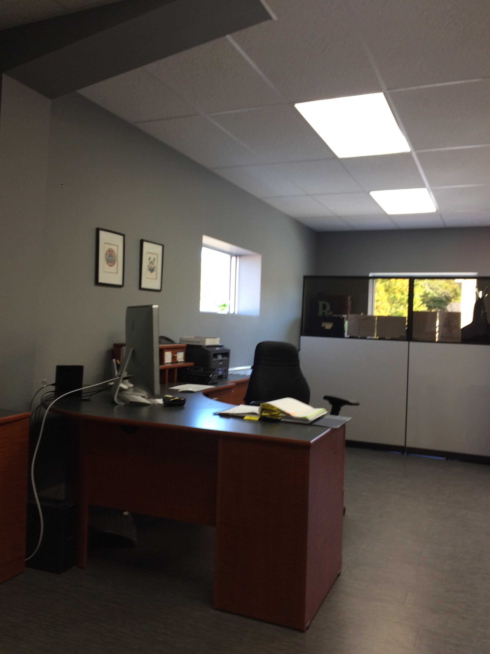
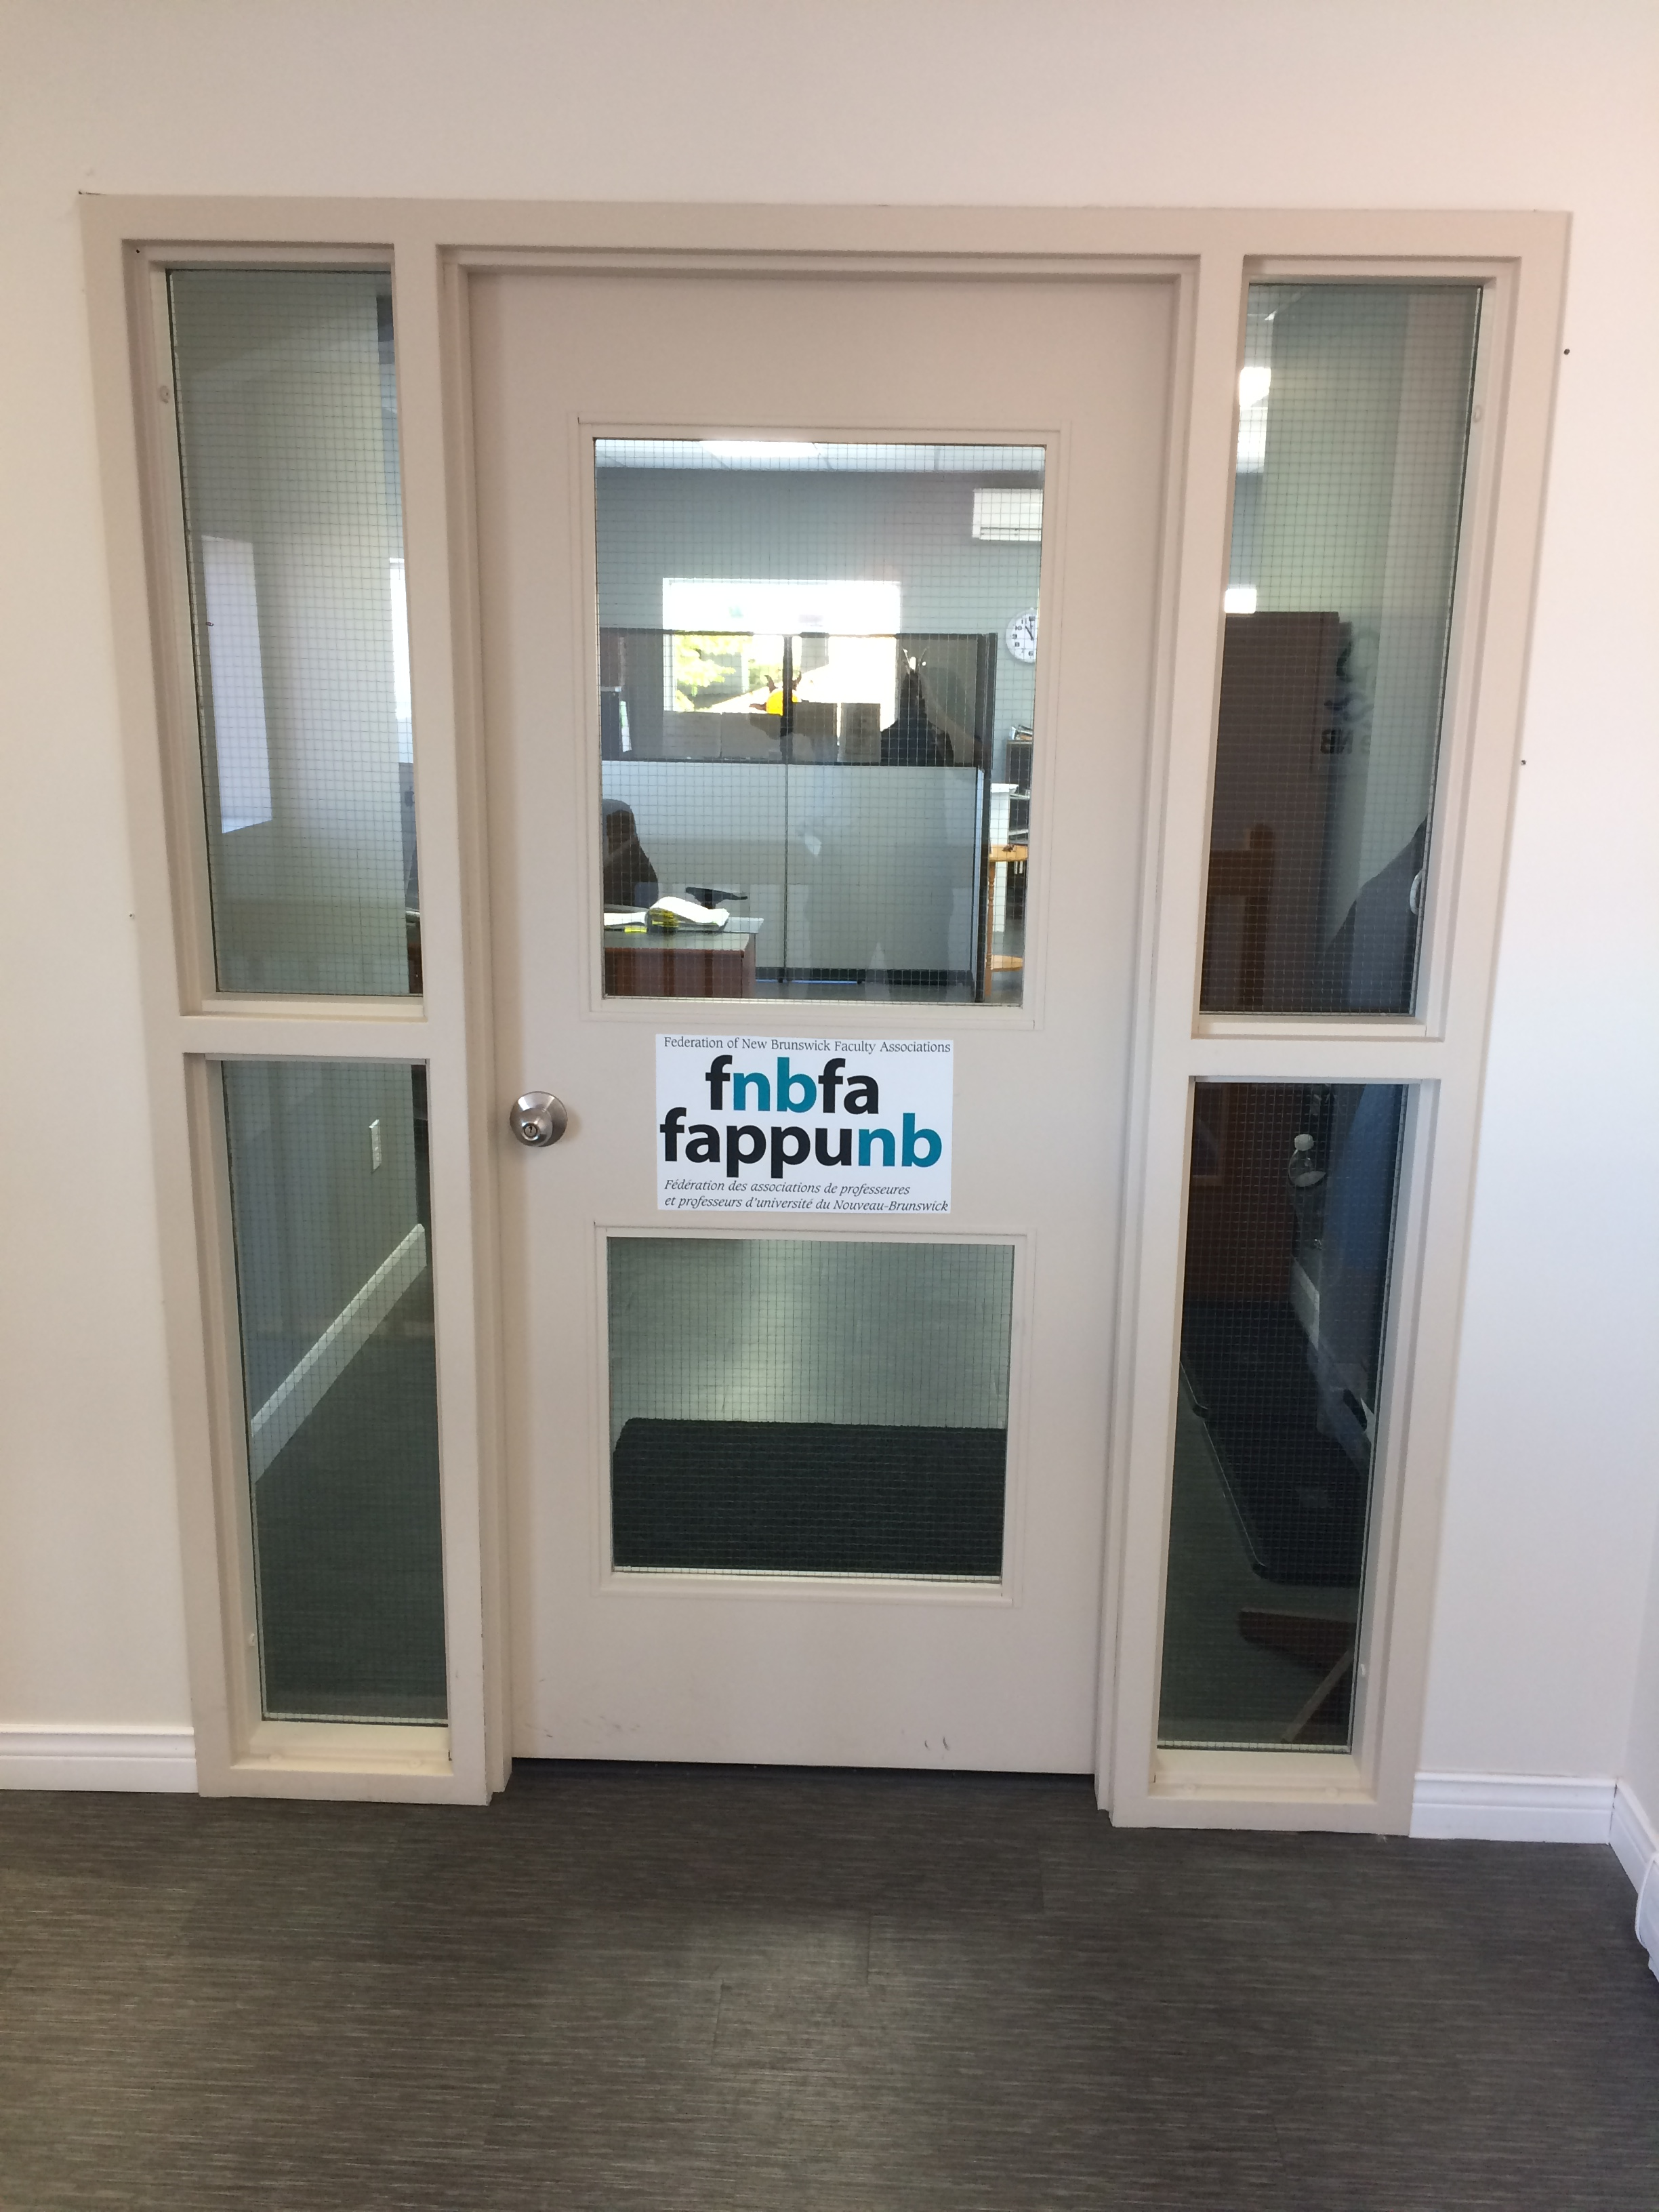
FNBFA Office: view from the inside

Slide 12
Critical work by the FNBFA
Resistance to McKenna’s wage freeze
Resistance to the Miner-L’Écuyer Report, the Government’s Self-Sufficiency Action Plan (2007)
Resistance to Conciliation Boards
Critical support during strikes and lock-outs
Requests under Right to Information and Protection of Privacy Act
Semeluk Scholarship (since 1991 – suspended – to be reviewed)
Lobbying for accessibility of post-secondary education

Slide 13
FNBFA Board of directors Rights and responsibilities
access to resources and files
notice of meetings
right to attend meetings
right to vote
right to review and approve minutes
introducing new business or raising concerns
(www.legal-info-legale.nb.ca)

Slide 14
Board of directors Rights and responsibilities
Legal Duties of Board Members
acting in the best interests of the organization
making informed decisions about the issues at hand
avoiding negligent or careless acts
taking reasonable steps to foresee and manage risks to the organization or others
avoiding conflict of interest

Slide 15
Board of directors Rights and responsibilities
To obey laws, bylaws and regulations by:
learning about the laws, bylaws and regulations that impact your organization
ensuring the organization is abiding by these
reading and asking questions to ensure you are complying with the organization’s governing documents
ensuring the organization’s governing documents are current and accurate

Slide 16
Current PSE issues
University funding
Transparency
Corporatization of universities
Research funding and research autonomy
Casualization of academic work
Autonomy of universities and performance indicators
Experiential learning
Indigenization of the academy
Accessibility to PSE and student debt

Slide 17
To know more…
Website: https://www.fnbfa.ca/
Facebook :
Fappunb Fnbfa
Twitter : @fnbfa

